Slide 1
Building Bridges: Communicating without a Shared Language Base
Alaina Webb and Sammie Sheppard
TSID 2013

Slide 2
Goals of this Workshop
Participants will have tools to identify persons whose communication system is outside the typical scope of interpreting or is non-existent.
Have a list of resource persons to contact when they have a client who is MLC.
Have a base level awareness of tools that can be used to establish communication with someone who is MLC.
Practice communicating simple concepts for someone identified as MLC.

Slide 3
What MLC Is and What It Is Not
Minimal Language Competency: (MLC) MLC interpreting is used for deaf clients with very little or basic communication skills. Communication is obtained by using auxiliary aids such as calendars to represent time, pictures, gestures, etc. This process can be very effective when done by a trained professional; however, it can take much longer to accomplish.
MLC is NOT a reflection of the intelligence of an individual, but rather their ability to communicate thought.

Slide 4
Identifying Persons Who Are MLC
A. Causes:
1. Language is inaccessible due to location/resources (including Deaf role models, well trained interpreters, etc…)
2. Esoteric home signs
3. Rudimentary formal signs
4. Accessibility only to a foreign sign language system.
5. Basic gestures (that may be built on very esoteric concepts.)

Slide 5
Identifying Persons Who Are MLC
What Clues do you see?
No recognizable sign system
No ability to read lips
No conceptually clear thought in writing
No ability to communicate basic personal information.
Came from a linguistically challenged background or environment.
Can communicate simple, basic personal information (name, age, address, DOB), but little or nothing beyond that.)

Slide 6
Identifying Persons Who Are MLC
What Clues do you see?
When asked standard questions in clear ASL, answers are unrelated to or inconsistent with the topic.
Confidence that the breakdown in communication is linguistic in nature and not a problem with the interpreter’s ability to convey the message clearly.

Slide 7
It is impossible for you to fill in ALL of the MLC client’s linguistic gaps.

Slide 8
TENETS:
Interpreters adhere to standards of confidential communication.
Interpreters possess the professional skills and knowledge required for the specific interpreting situation.
Interpreters conduct themselves in a manner appropriate to the specific interpreting situation.
Interpreters demonstrate respect for consumers.
Interpreters demonstrate respect for colleagues, interns, and students of the profession.
Interpreters maintain ethical business practices.
Interpreters engage in professional development.
Click here to access the full version of the NAD-RID Code of Professional Conduct

Slide 9
This Workshop Will Focus On:
Confidentiality 1.1 – Share assignment related information only on a confidential and “as needed” basis.
Professionalism 2.2 – 2.6 – Interpreters possess the professional skills and knowledge required for the specific interpreting situation.
Conduct 3.1, 3.2, 3.3, 3.4, 3.7, 3.8 – Interpreters conduct themselves in a manner appropriate to the specific interpreting situation.

Slide 10
This Workshop Will Focus On:
Respect for Consumers 4.1, 4.2, &4.4 – Interpreters demonstrate respect for consumers.

Slide 11
So What Do I Do Now?!
GET HELP!!!! Know your local resources in your area.
Ideally a CDI
www.dars.state.tx.us/dhhs/beiterpsearch.shtml
A highly certified, highly experienced interpreter with training in this area.
Someone you can call 24/7 for THIS REASON.
DARS Representatives: your local Deafness Resource Specialist, Randi Turner, Doug Dittfurth, Ann Horn, etc…
Local ITP Directors and Instructors, Deaf pastors, etc.
Legal – Carla Mathers, Anna Witter- Merrithew
IF YOU ARE WORKING VIA AN AGENCY, CALL THEM FIRST!

Slide 12
Unique Challenges
Time Related concepts
Abstract concepts
Details of a concept
Conceptual thought based on cultural exposure of either the interpreter and/or the client.
Lack of or extremely limited exposure to formal education.
Multiple cultural deficits (settings, linguistic, etc…)

Slide 13
WE ALL HAVE DEFICITS!

Slide 14
What Tools Should Be in Your Tool Box?
Know the CPC ethical parameters for this situation.
The ability to look beyond standard perceptions and from a million different angles.
Teaming- linguistic tools can be shared without compromising neutrality.
How teaming roles are applied to meet the needs of an MLC client.
Concrete tools to communicate a wide variety of concepts.

Slide 15
The Adjusted Flow of Interpreting
Forget simultaneous – work in consecutive mode.
Know how to speak professionally and with specific terminology to hearing participants about the need for adjusted interpreting techniques.
Time constraints are going to have to be laid aside.

Slide 16
Consecutive vs. Simultaneous
Simultaneous interpreting requires both parties have an in-depth knowledge of a shared language base that is implicit.
Implicit knowledge is “the unconscious knowledge of a much larger body of information that is the basis of automatic, spontaneous use of language” (Little 1994:103), which is intuitive, tacit, and proceduralized. It can be accessed without much conscious deliberation

Slide 17
Consecutive vs. Simultaneous
Without this shared language base the use of simultaneous interpreting is not only ineffective, but an unethical choice in an MLC situation.
Consecutive Interpreting allows for time to break concepts into very small chunks at a pace that allows the Deaf consumer time to process.
It also allows time for the interpreter to work through a variety of tools to find the best choice for communicating a particular concept.

Slide 18
Professional Terminology with Hearing Clients
Above all, be professionally assertive and polite. Speak intelligently in terms familiar to the hearing professionals in the setting. If you are rude and unprofessional, you will have a negative influence on the proceedings and impede the Deaf person getting what they need.
Notes:
Know when to push for things, when to change tactics, and when and what to drop. Words such as “accent,” “dialect,” “accessibility”, etc. are better than using interpreter jargon like “sign style,” “regionalisms,” etc. Take care not to become confrontational, and try to reword your request if you meet with resistance on something important.

Slide 19
Who Do I Talk To:
Court – the Judge ultimately must approve everything. Also need to know the court coordinator and attorneys for both sides.
Hospitals – Doctor handling case writes all the orders. Charge nurses can be helpful, patient advocates/guest services are very important to know.
Schools – classroom instructor, Deaf Ed teacher, interpreter, principal, vice-principal, counselor, and possibly diagnostician.
Pre and post sessions are CRITICAL!! The ability to negotiate professionally is imperative.
Notes:
In legal and mental health settings, pre- and post-session meetings help ensure your interpreting keeps in line with where the attorney/doctor/psychiatrist is trying to go. Some abstract or intentionally confusing rhetoric will be unavoidably lost when working with an MLC client. However, it is still imperative to discuss and negotiate how you will proceed beforehand, and go over how it went, what adjustments had to be made, and other issues after the session is done. This helps in planning for the next meeting.

Slide 20
Professional Terminology with Hearing Clients
“Legally Liable” – Courts, hospitals, schools, etc… are legally liable to provide language communication in the mode best understood by the Deaf client.
“Linguistically present” – (Thank you, Carla Mathers!) often used in court as in “linguistically present for their defense.” The Deaf person has a right to have someone who can get to the communication mode best understood by the Deaf person.
“Unique Dialect” – (Thank you, Kristin Lund! ☺) This helps the hearing person relate the experiences to what they have dealt with in ESL situations involving spoken language.
Notes:
Doctors, psychiatrists, and attorneys fully understand “legal liability.”

Slide 21
Time Constraints
This is not a typical interpreting situation.
Will require extensive linguistic analysis by the interpreter initially.
Based on the findings of the initial analysis, will require extensive time to establish concept communication modes.
What might take hours in a typical situation may now stretch over weeks and months.
Will require extensive scheduling over several sessions by multiple parties.
Notes:
Hearing people are most concerned with TIME and MONEY. Working with an MLC client flies in the face of both of these concerns. Hearing people will be less likely to understand and more likely to balk at the additional needs presented with these clients. Be patient, and stay on track.

Slide 22
Time Constraints Interpreter Consideration
If you know you are not going to be available for an extended period of time, say no up front. Don’t add time to an already complicated process.
Notes:
Imagine the confusion and additional work, stress, etc. of having to adjust to another person, another unfamiliar communication style, the confusion of trying to establish signs/concepts for things that have already been laid, but are unknown to the new interpreter, etc.

Slide 23
Channel Your Inner Sherlock Holmes
What country are they from?
What language are they most likely to have seen in some form?
What foods, customs, holidays might they be familiar with?
FIND A CONCEPTUAL BASE TO START WITH!!
YOU MUST WORK FROM CONCRETE TO ABSTRACT
Notes:
Even without formal language, this person has experienced LIFE. Find common ideas that he/she understands, and build connections from there. (ie Birth certificate in form/language from country of origin and help build the bridge to what a birth certificate from the US looks like). Be careful with UNCOMMON holidays: Thanksgiving, Christmas, Easter, Fourth of July, etc.

Slide 24
Building Your MLC Toolbox
You should own a smart phone or a tablet. Take it with you everywhere.
Dry erase board and markers (colors).
Manipulatives relevant to the situation if you have that information. Think about foods, cars, seasons, hygiene, first responders, school activities, ID, social security cards, money, checkbook, multiple types/years of calendars, weather, clothing, drugs, bills, etc…..
Pictures of persons or places relevant to the situation.
Notes:
You will use the smart phone/tablet for everything! Worth the investment. Google is your friend!
Dry erase boards are inexpensive. Walmart or Target has them for $6-$10. Colored pens can help, but take care not to confuse a basic concept by adding an additional, unrelated detail. Colored pens can be used to show a change of idea, concept, etc.
Avoid pictures/manipulatives with lots of detail. Separate “things” from color, size, etc. Details are added in layers once each “larger” concept is established. Don’t forget to use what you have at your fingertips (your own comb, checkbook, lipstick, phone, etc.)
Take advantage of thrift stores, $1 aisles in Walmart or Target, things you have lying around your house, and other inexpensive options for building your toolbox.

Slide 25
Hands on Practice
Repetition, repetition, repetition!!!!
Teams of 3: 1 MLC Interpreter
1 MLC Client
1 Person to Analyze
You have 5 minutes to get the concept across, 2 minutes for feedback
Rotate Positions

Slide 26
Scenario #1- Instructions for Medication
“Start this medication tomorrow by taking 2 pills tomorrow, and 1 pill a day for the remaining 4 days.

Slide 27
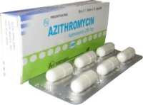
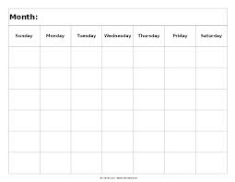
Did You Consider:

Slide 28
Scenario #2 - Educational
Due to teacher in-service there will be no school next Monday. Buses will resume their normal routes next Tuesday at 7:45

Slide 29
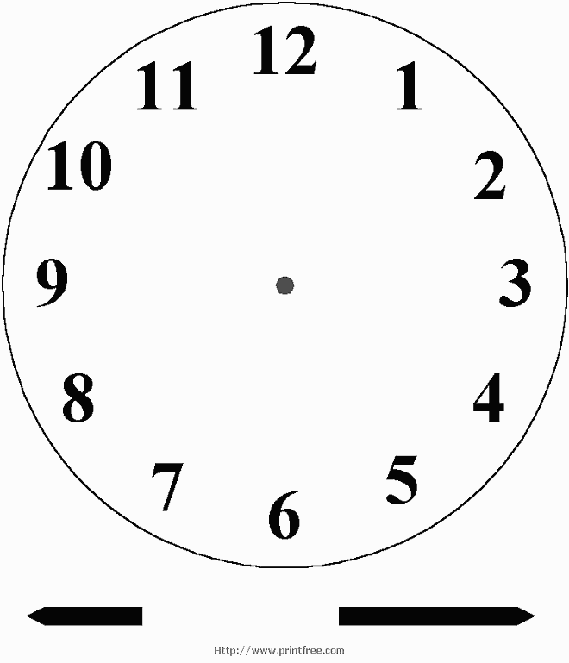
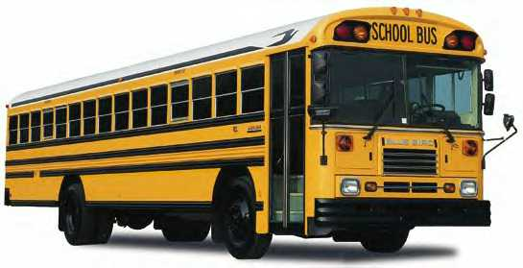
Did You Consider:

Slide 30
Scenario #3 - Legal
Did you meet the suspect before or after you were arrested for prostitution October 2010?

Slide 31
Did You Consider:

Slide 32
Teaming
Must share name signs.
Must share unique the conceptual signs/gestures
Must share unique concept acquisition tools.
The shared information must be 100% linguistically based so as not to bias the interpretation.
Notes:
Share accepted substitutions of signs that have actual concepts that are not used. Share “notebook” or other manipulatives. Share known limitations or other linguistic restraints that will affect the message. NOT “the story” behind what’s going on. Very difficult to draw the line at times, but use the litmus test of “Is this LINGUISTICS related?”

Slide 33
Confidentiality
Tenet 1.0
Interpreters hold a position of trust in their role as linguistic and cultural facilitators of communication. Confidentiality is highly valued by consumers and is essential to protecting all involved.
Illustrative behaviors:
Share assignment-related information only on a confidential and “as-needed” basis (e.g., supervisors, interpreter team members, members of the educational team, hiring entities).
Manage data, invoices, records, or other situational or consumer-specific information in a manner consistent with maintaining consumer confidentiality (e.g., shredding, locked files).

Slide 34
Confidentiality
The Deaf community is a familial group. The MLC population inside the community is extremely small, and therefore, figuring out who you are working with could be easy.
Share information that is necessary for consistency, but be careful not to share so much that it takes away from the confidentiality of the client involved.

Slide 35
Professionalism
Tenet 2.0
Interpreters possess the professional skills and knowledge required for the specific interpreting situation.
Illustrative behaviors:
2.2 Assess consumer needs and the interpreting situation before and during the assignment and make adjustments as needed.
2.3 Render the message faithfully by conveying the content and spirit of what is being communicated, using language.

Slide 36
Professionalism (continued)
2.4 Request support (e.g., certified deaf interpreters, team members, language facilitators) when needed to fully convey the message or to address exceptional communication challenges (e.g. cognitive disabilities, foreign sign language, emerging language ability, or lack of formal instruction or language).
2.6 Judiciously provide information or referral regarding available interpreting or community resources without infringing upon consumers’ rights.

Slide 37
Conduct
Tenet 3.0
Interpreters conduct themselves in a manner appropriate to the specific interpreting situation.
Illustrative behaviors:
3.1 Consult with appropriate persons regarding the interpreting situation to determine issues such as placement and adaptations necessary to interpret effectively
3.2 Decline assignments or withdraw from the interpreting profession when not competent due to physical, mental, or emotional factors.

Slide 38
Conduct (continued)
3.3 Avoid performing dual or conflicting roles in interdisciplinary (e.g. educational or mental health teams) or other settings.
3.4 Comply with established workplace codes of conduct, notify appropriate personnel if there is a conflict with this Code of Professional Conduct, and actively seek resolution where warranted.
3.7 Disclose to parties involved any actual or perceived conflicts of interest.
3.8 Avoid actual or perceived conflicts of interest that might cause harm or interfere with the effectiveness of interpreting services.

Slide 39
Respect for Consumers
Tenet 4.0
Interpreters demonstrate respect for consumers.
Illustrative behaviors:
4.1 Consider consumer requests or needs regarding language preferences, and render the message accordingly (interpreted or transliterated).
4.2 Approach consumers with a professional demeanor at all times.
4.4 Facilitate communication access and equality, and support the full interaction and independence of consumers.

Slide 40
Credits
“Code of Professional Conduct.” Registry of Interpreters for the Deaf. RID.org, n.d. Web. 18 June, 2013. http://rid.org/UserFiles/File/NAD_RID_ETHICS.pdf
“Services for Persons Who Are Deaf of Hard of Hearing.” Texas Department of Assistive and Rehabilitative Services. DHHS, n.d. Web. 18 June, 2013. http://www.dars.state.tx.us/dhhs/index.shtml
“BEI Interpreter Search.” Texas Department of Assistive and Rehabilitative Services. DHHS, n.d. Web. 18 June, 2013. http://www.dars.state.tx.us/dhhs/beiterpsearch.shtml
“DHHS Specialist Program.” Texas Department of Assistive and Rehabilitative Services. DHHS, n.d. Web. 18 June, 2013. http://www.dars.state.tx.us/dhhs/specialistpgm.shtml
Paradowski, Michal. “Explicit vs. implicit and declarative vs. procedural language learning.” Sciencebin. 14 November, 2008. Web. 18 June, 2013. http://sciencebin.wordpress.com/article/explicit-vs-implicit-and-declarative-vs-2qpvzotrrhys1-11/

